Slide 1
Just Wars
What do you think a Just War is?

Slide 2
Big Picture
Understand the theory of Just War
Tasks
Cause of War discussion
Writing
Debate
Reflection
6mark question

Slide 3
Outcomes
All to understand what is a Just War
All to know the conditions of a Just War
Most to take part in a discussion on Just War
Most to complete a 6 mark exam question
Few to be able to aware of variety of arguments surrounding Just War

Slide 4
Cause of the War
Background to the Palestine conflict:
The Jews and the Arabs both regard the same area as their homeland
Israel occupied much of Palestine after a war in 1967.
The Palestinians want their land back, but Israel will only give it back if the Palestinians agree to Israel having the other land.

Slide 5
Cause of the War
Background to the Kashmir conflict:
When Britain left India in 1947 the majority of Muslims areas of the north did not join India but became the Muslim state of West Pakistan and East Pakistan (now Bangladesh)
Kashmir was mainly Muslim, but did not join Pakistan because the ruler was Hindu and there were a lot of Hindus in Kashmir.
Ever since Pakistan and Muslim Kashmir rebels have been fighting to make Kashmir an independent Muslim state

Slide 6
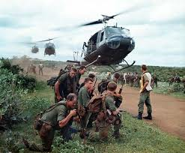
War is sometimes unavoidable and so can be justified. The theory to decide whether a war is justified is know as the just war theory.
Linked to Thomas Aquinas in Christianity it is also known in Hinduism, Islam, Judaism and Buddhism

Slide 7
What is a Just War?
Six conditions must be satisfied for a war to be considered just:
The war must be for a just cause.
The war must be lawfully declared by a lawful authority (e.g.UN).
The intention behind the war must be good e.g. peace.
All other ways of resolving the problem should have been tried first.
There must be a reasonable chance of success.
The means used must be in proportion to the end that the war seeks to achieve.
How should a Just War be fought?
A war that starts as a Just War may stop being a Just War if the means used to wage it are inappropriate.
Innocent people and non-combatants should not be harmed.
Only appropriate force should be used.
This applies to both the sort of force, and how much force is used.
Internationally agreed conventions regulating war must be obeyed.

Slide 8
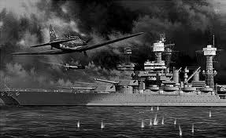
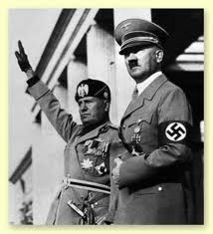
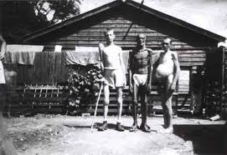
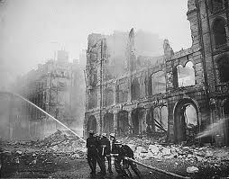
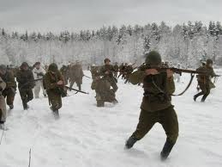
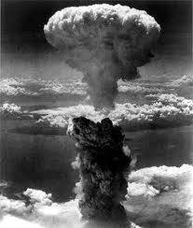
Put it to the Test...... WW2

Slide 9
Reflection
Can a war ever be just?
Use examples?
‘war can never be right.’
Do you agree? Give reasons for your opinion? 3marks
Give reasons why some people may disagree with you. 3marks
In your answer you should refer to at least one religion

