Slide 1
Situation Ethics
What is meant by situation ethics?

Slide 2
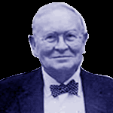
Situation Ethics is..
The Bible says keep the Sabbath day holy however you need the additional money from working on a Sunday to keep your business and family afloat?
Idea decisions should be based on the most loving thing to do. Idea began with an American Christian thinker Joseph Fletcher.
Fletcher felt that just using the Bible was wrong so instead should use Jesus’ commandment to love your neighbour as yourself and on the situation. The elements of situation ethics were described by Joseph Fletcher;
Moral judgments are decisions, not conclusions
Decisions ought to be made situationally, not prescriptively
We should seek the well-being of people, rather than love principles.
Lets give it a go?
Abortion is wrong however a girl of 14 has been raped by her step father and is pregnant?

Slide 3
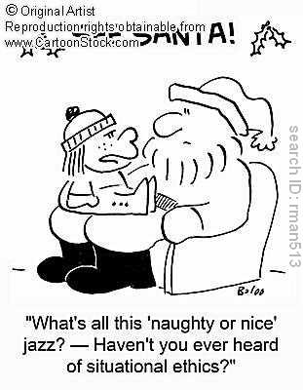
Big Picture
Moral decision making – another way is the use of situation ethics.
Skills – creative thinker
A01 and A02

Slide 4
Outcomes
All will know what is meant by situation ethics
Most will use situation ethics for making a decision on two scenarios
Most will answer a two exam style questions using information provided in the lesson to a grade B level.
Few will look into a specific ethical issue and decide if there is an answer

Slide 5
Debate between Christians
Why Christians use SE as a guide | Why some Christians think SE is wrong
Jesus healed a man on a Sabbath day. Wrong to ignore the consequences of actions. You should only do what produces good results Jesus said only laws are to love God and love your neighbour, means that Christians should always do what will have the most loving results Christianity is the religion of love and forgiveness | They think God would not have given laws in the Bible if they were not to be followed We should follow the 10 Commandments The Church knows better what Christians should do than the individual They claim you can never know all the facts

Slide 6
Questions - Timed
Do you think situation ethics is a good way of making moral decisions? Give two reasons for your points of view (4)
Explain why some Christians believe situation ethics is the most Christian way of making moral decisions. (8)

Slide 7
A Just War
Is there such a thing?
Remember the key principles
Six fundamental principles:
Love only is always good ‘Only one ‘thing’ is intrinsically good; namely, love: nothing else at all’
Love is the only norm (rule) ‘The ruling norm of Christian decision is love: nothing else’
Love and justice are the same "Love and justice are the same, for justice is love distributed, nothing else."
Love is not liking "Love wills the neighbor’s good whether we like him or not."
Love justifies the means "Only the end justifies the means; nothing else,"
Love decides there and then

Slide 8
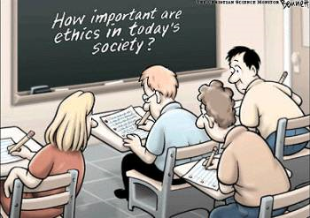
Review
What do you think?
Bible
Church
Conscience
Situation Ethics
Tell the person next to you what you think is the best way of making moral decisions and why?

